Slide 1
Seq2seq Models
Lecturer: Eilam Shapira
NLP Course - Units 7 - Lecture Based on Amir Feder's slides & Stanford’s CS224n

Slide 2
Today’s Agenda
Short recap (RNN, LSTM)
Machine Translation (Seq2seq)
Attention

Slide 3
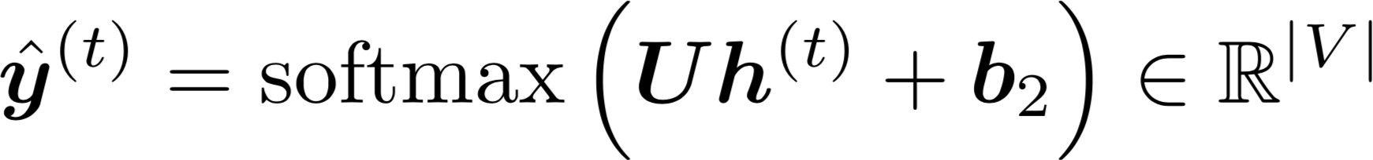

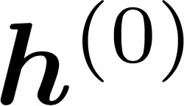
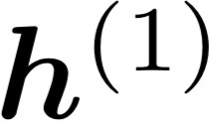
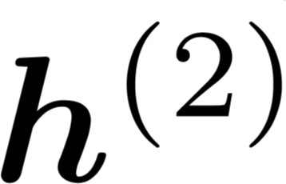
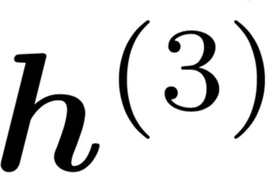
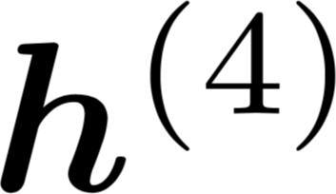



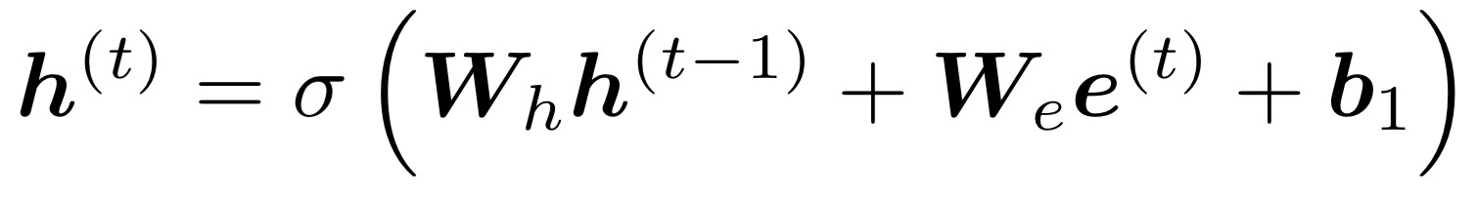
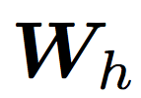




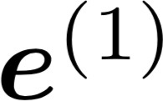

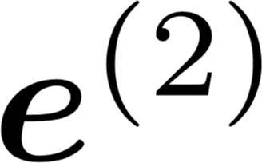
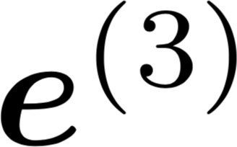

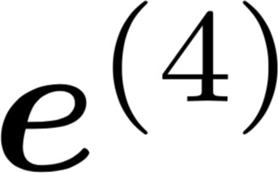
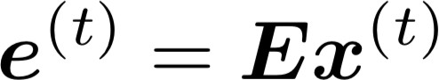



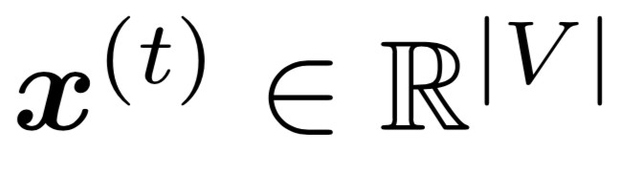
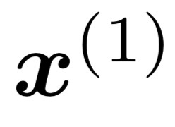
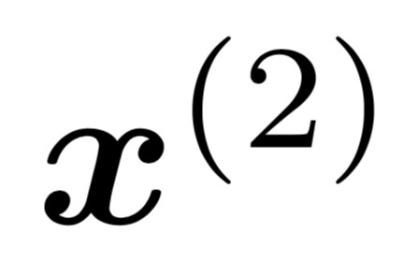
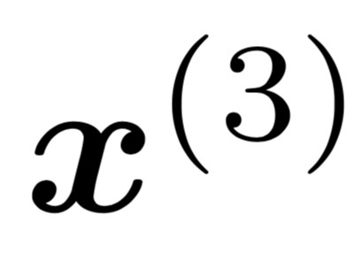
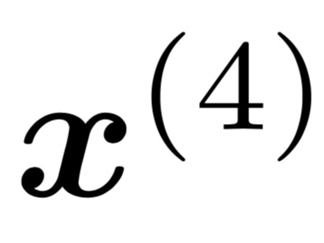
A Simple RNN Language Model
books
laptops
output distribution
a
zoo
hidden states
is the initial hidden state
word embeddings
words / one-hot vectors
the students
opened
their
Note: this input sequence could be much longer now!

Slide 4
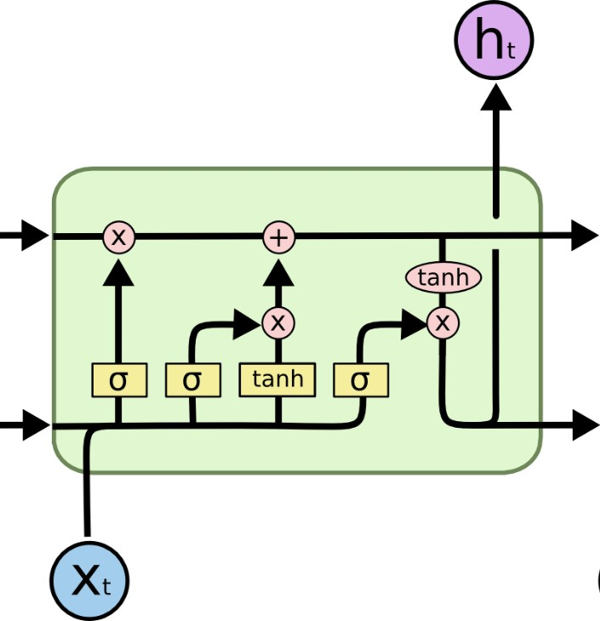
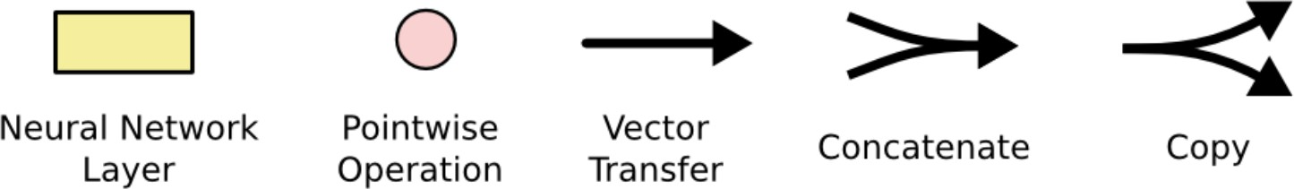
Long Short-Term Memory (LSTM)
You can think of the LSTM equations visually like this:
Write some new cell content
The + sign is the secret!
Forget some cell content
c_{t}
c
^{c}t-1
t
f
i_{t}
o_{t}
Output some cell content to the hidden state
Compute the forget gate
t
~_{c}
t
^{h}t-1
h_{t}
Compute the input gate
Compute the new cell content
Compute the output gate
Source: http://colah.github.io/posts/2015-08-Understanding-LSTMs/

Slide 5
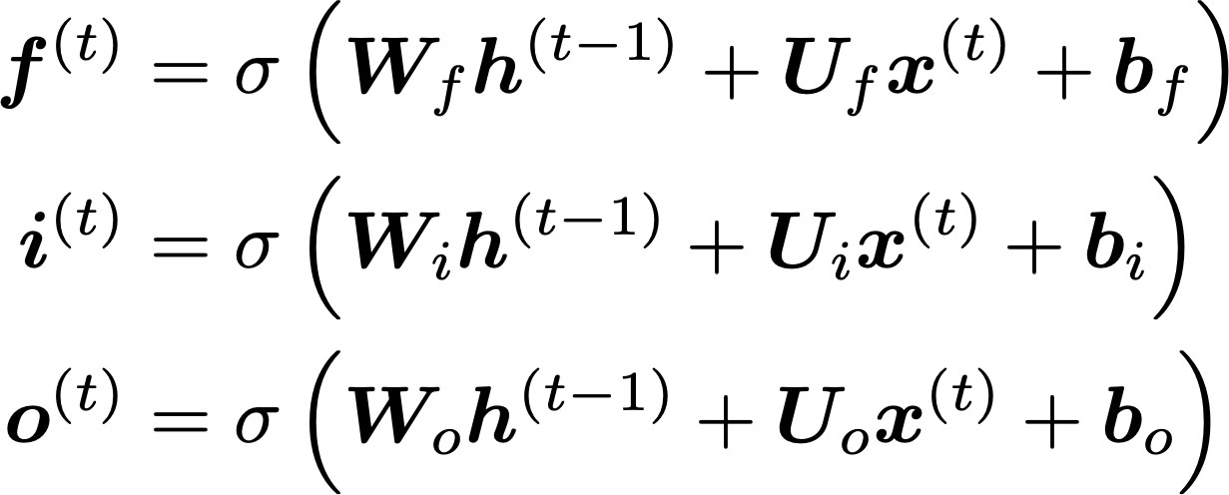
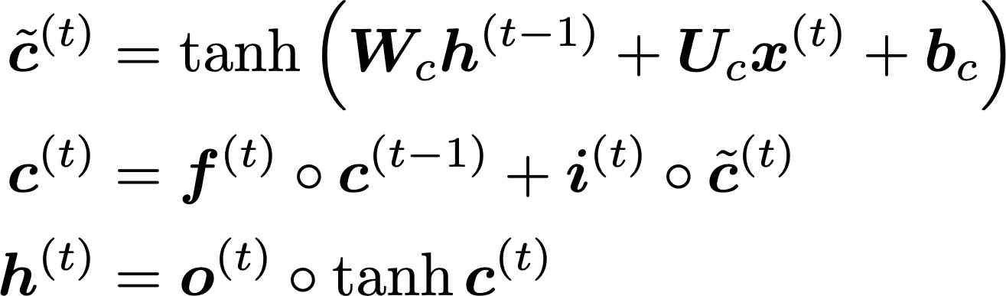
Long Short-Term Memory (LSTM)
We have a sequence of inputs 𝑥^{(")}, and we will compute a sequence of hidden states ℎ^{(")} and cell states
𝑐^{(")}. On timestep t:
Sigmoid function: all gate values are between 0 and 1
Forget gate: controls what is kept vs forgotten, from previous cell state
Input gate: controls what parts of the new cell content are written to cell
Output gate: controls what parts of cell are output to hidden state
New cell content: this is the new content to be written to the cell
All these are vectors of same length n
Cell state: erase (“forget”) some content from last cell state, and write (“input”) some new cell content
Hidden state: read (“output”) some content from the cell
Gates are applied using element-wise (or Hadamard) product: ⊙

Slide 6
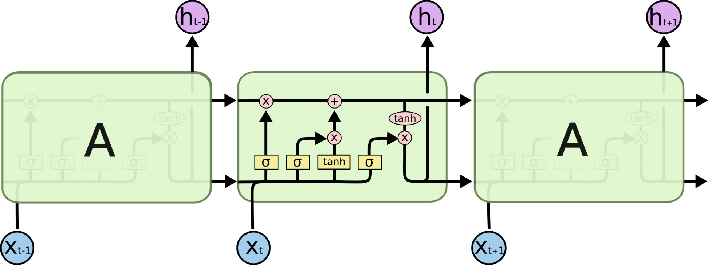
Long Short-Term Memory (LSTM)
You can think of the LSTM equations visually like this:
Source: http://colah.github.io/posts/2015-08-Understanding-LSTMs/

Slide 7
Today’s Agenda
Short recap (RNN, LSTM)
Machine Translation (Seq2seq)
Attention

Slide 8
Machine Translation
Machine Translation (MT) is the task of translating a sentence x from one language (the source language) to a sentence y in another language (the target language).
x:
L'homme est né libre, et partout il est dans les fers
y:
Man is born free, but everywhere he is in chains
– Rousseau

Slide 9
The early history of MT: 1950s
Machine translation research began in the early 1950s on machines less powerful than high school calculators
Foundational work on automata, formal languages, probabilities, and information theory
MT heavily funded by military, but basically just simple rule-based systems doing word substitution
Human language is more complicated than that, and varies more across languages!
Little understanding of natural language syntax, semantics, pragmatics
Problem soon appeared intractable
1 minute video showing 1954 MT: https://youtu.be/K-HfpsHPmvw

Slide 10
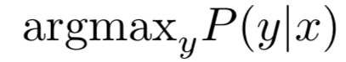
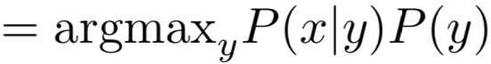
1990s-2010s: Statistical Machine Translation
Core idea: Learn a probabilistic model from data
Suppose we’re translating French → English.
We want to find best English sentence y, given French sentence x
Use Bayes Rule to break this down into two components to be learned separately:
Translation Model
Models how words and phrases should be translated (fidelity).
Learnt from parallel data.
Language Model
Models how to write good English (fluency).
Learnt from monolingual data.

Slide 11
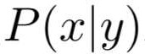
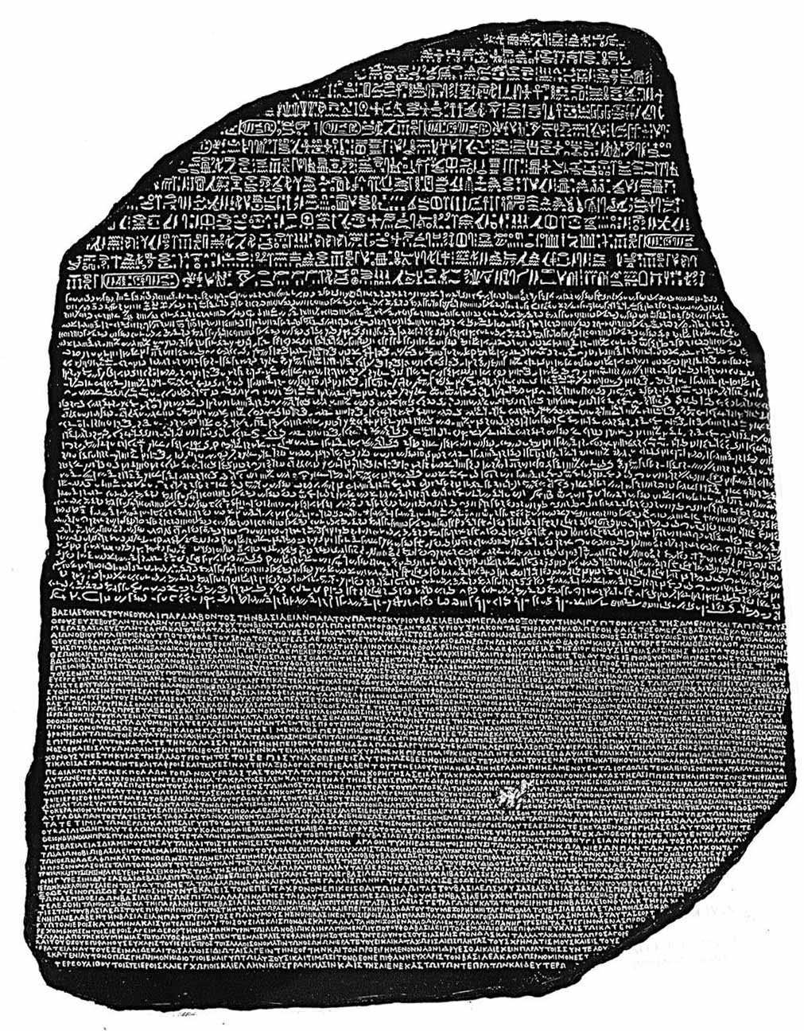
1990s-2010s: Statistical Machine Translation
Question: How to learn translation model ?
First, need large amount of parallel data
(e.g., pairs of human-translated French/English sentences)
The Rosetta Stone
Ancient Egyptian
Demotic
Ancient Greek

Slide 12
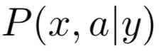
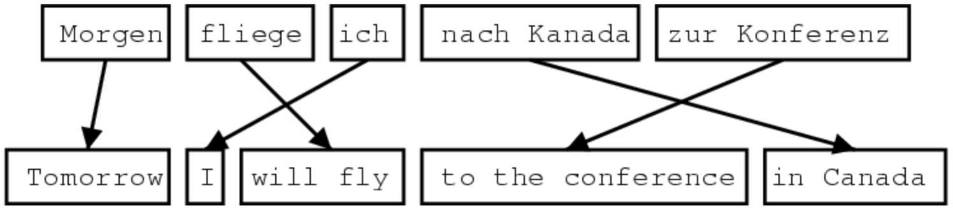
Learning alignment for SMT
Question: How to learn translation model from the parallel corpus?
Break it down further: Introduce latent a variable into the model:
where a is the alignment, i.e. word-level correspondence between source sentence x
and target sentence y

Slide 13
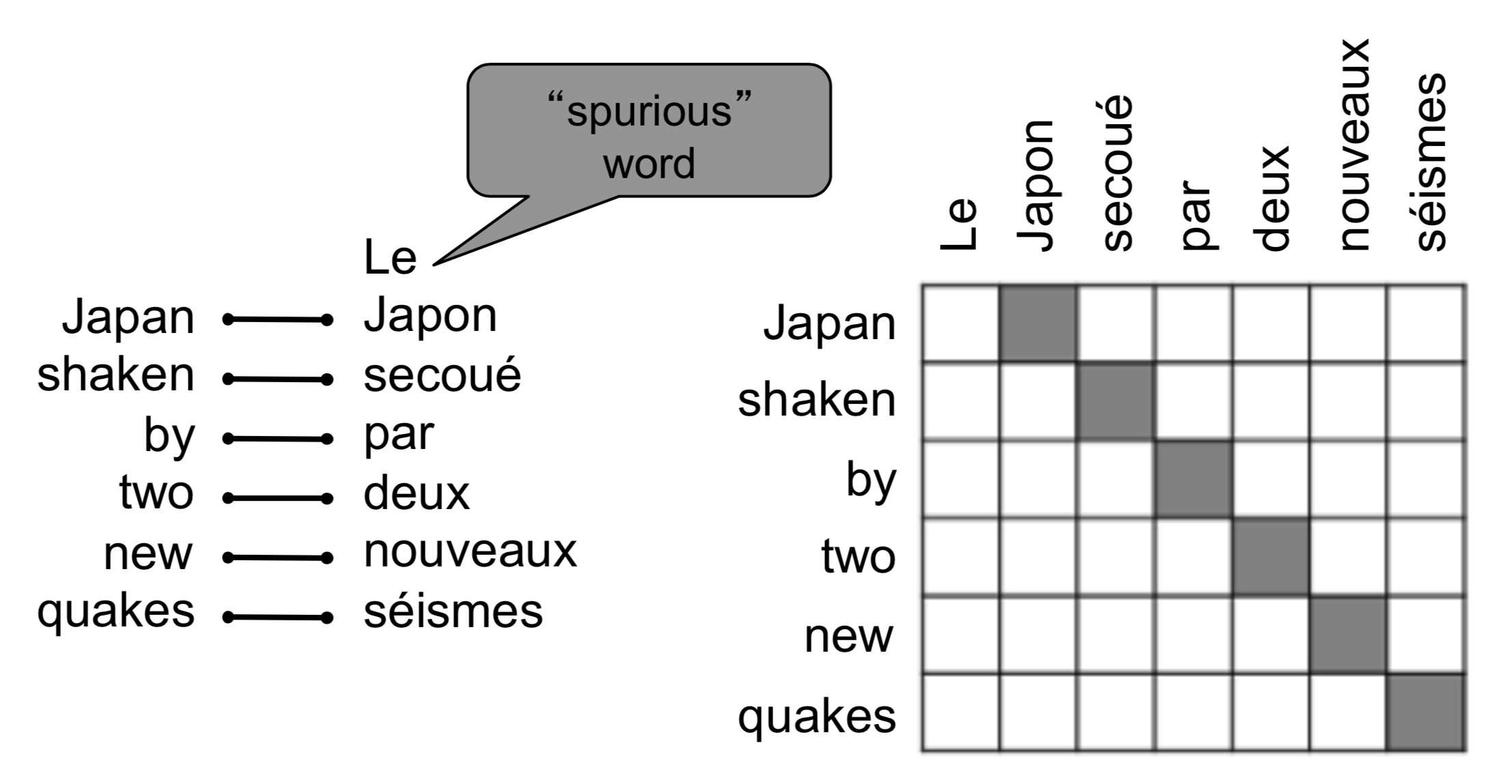
What is alignment?
Alignment is the correspondence between particular words in the translated sentence pair.
Typological differences between languages lead to complicated alignments!
Note: Some words have no counterpart
Examples from: “The Mathematics of Statistical Machine Translation: Parameter Estimation", Brown et al, 1993. http://www.aclweb.org/anthology/J93-2003

Slide 14
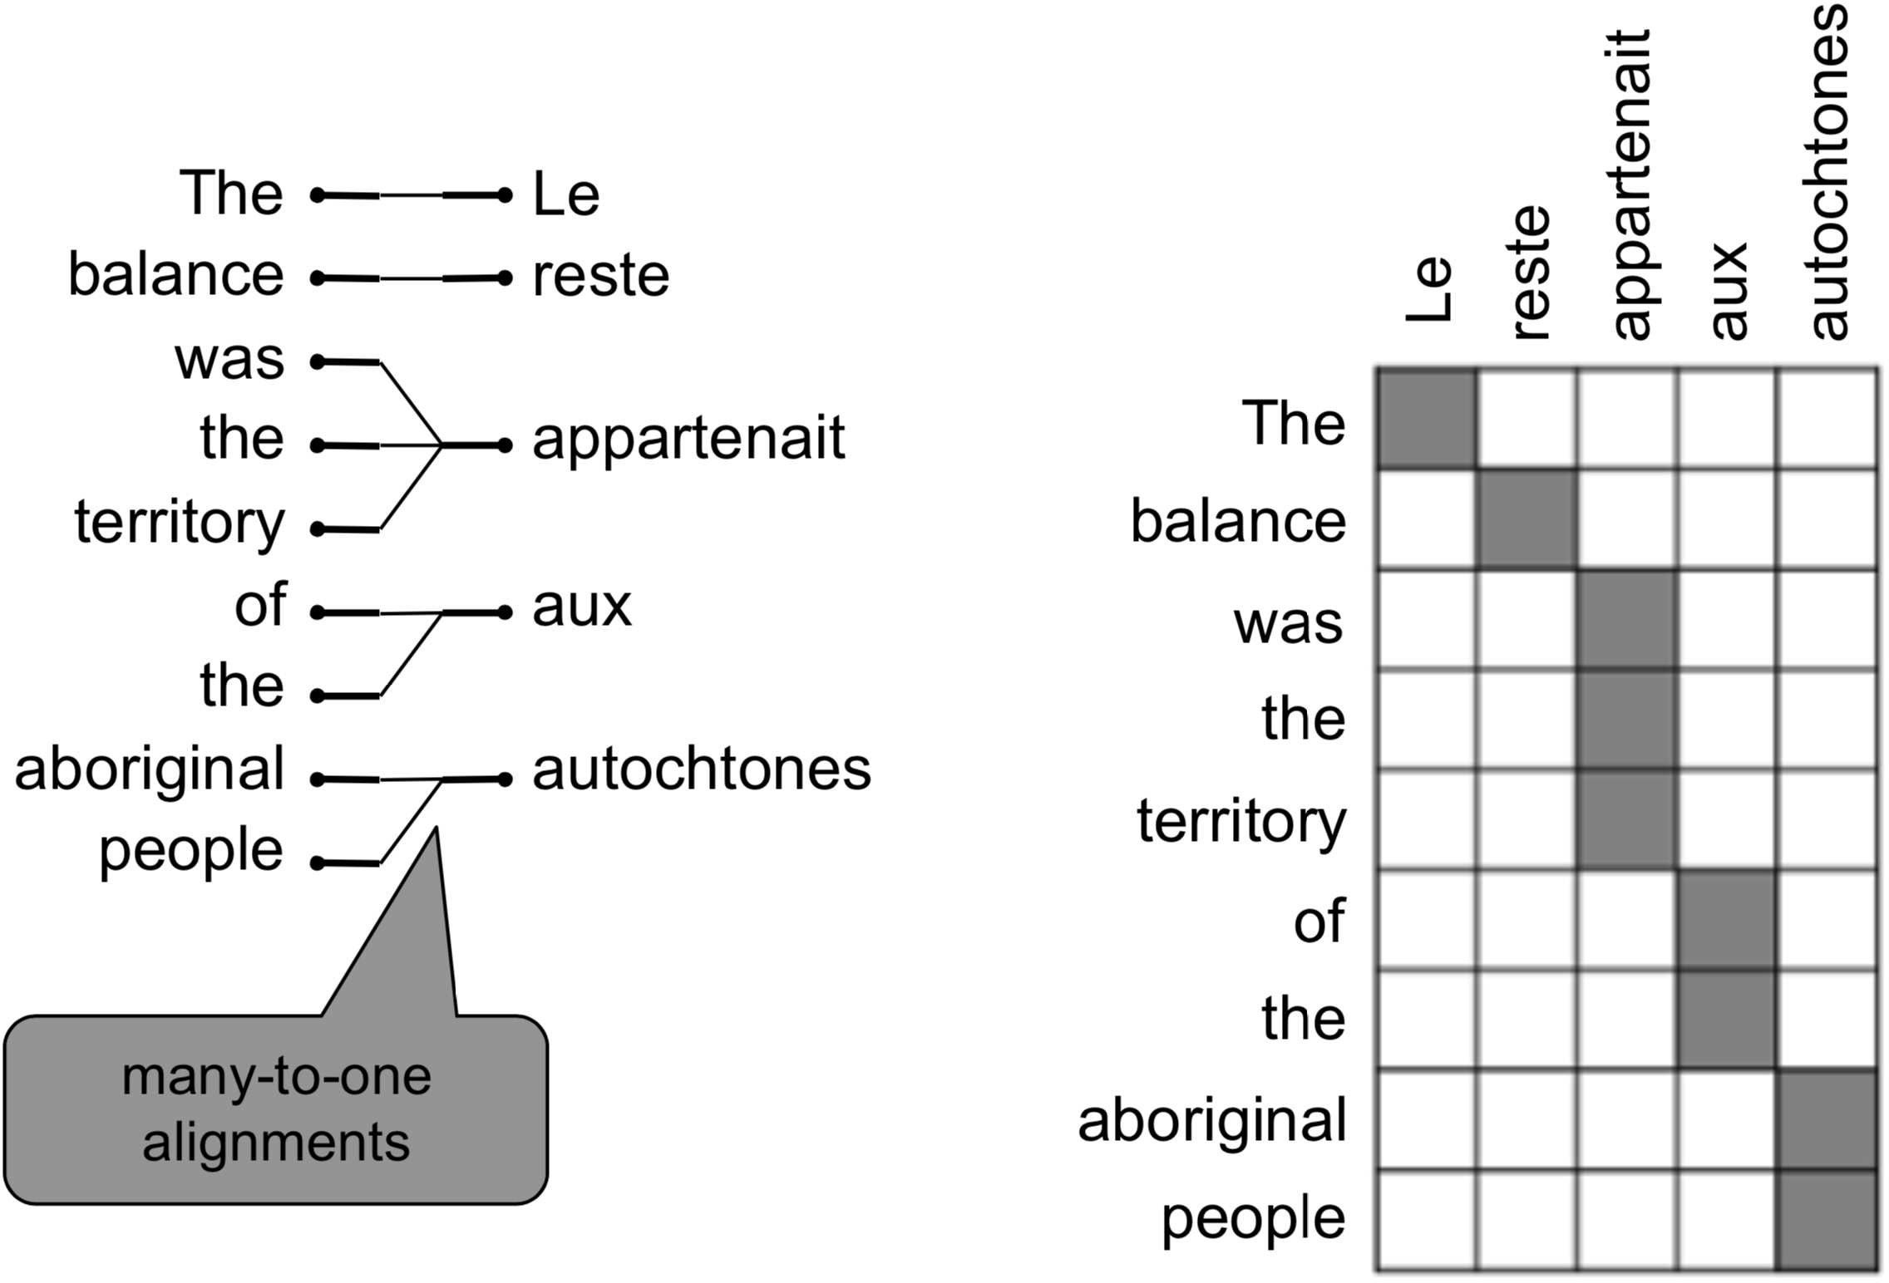
Alignment is complex
Alignment can be many-to-one
Examples from: “The Mathematics of Statistical Machine Translation: Parameter Estimation", Brown et al, 1993. http://www.aclweb.org/anthology/J93-2003

Slide 15
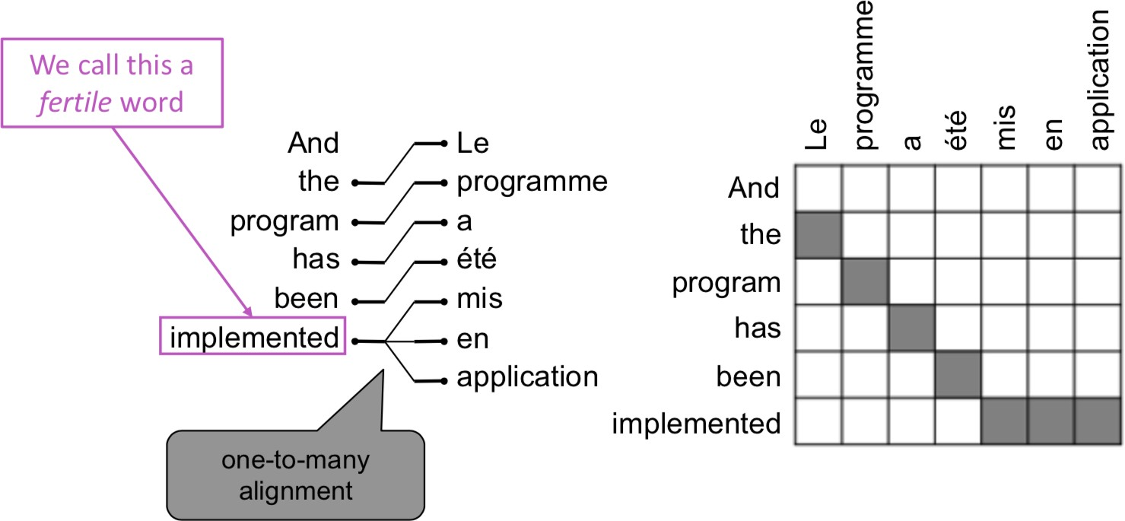
Alignment is complex
Alignment can be one-to-many
Examples from: “The Mathematics of Statistical Machine Translation: Parameter Estimation", Brown et al, 1993. http://www.aclweb.org/anthology/J93-2003

Slide 16
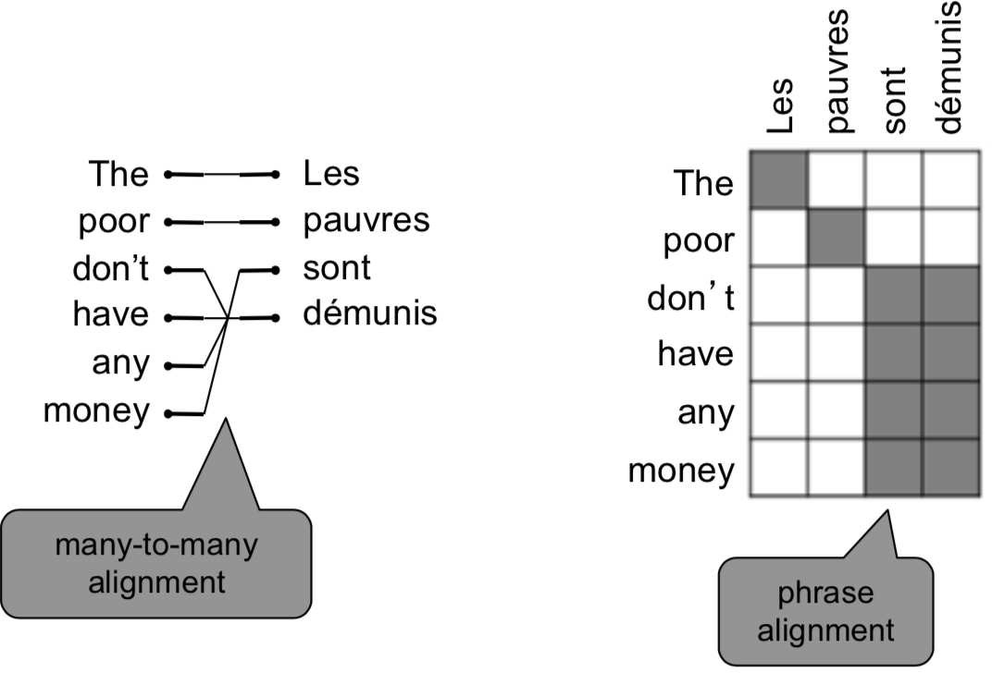
Alignment is complex
Alignment can be many-to-many (phrase-level)
Examples from: “The Mathematics of Statistical Machine Translation: Parameter Estimation", Brown et al, 1993. http://www.aclweb.org/anthology/J93-2003

Slide 17
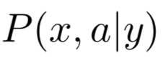
Learning alignment for SMT
We learn as a combination of many factors, including:
Probability of particular words aligning (also depends on position in sent)
Probability of particular words having a particular fertility (number of corresponding words)
etc.
Alignments a are latent variables: They aren’t explicitly specified in the data!
Require the use of special learning algorithms (like Expectation-Maximization) for learning the parameters of distributions with latent variables

Slide 18
1990s-2010s: Statistical Machine Translation
SMT was a huge research field
The best systems were extremely complex
Hundreds of important details we haven’t mentioned here
Systems had many separately-designed subcomponents
Lots of feature engineering
Need to design features to capture particular language phenomena
Require compiling and maintaining extra resources
Like tables of equivalent phrases
Lots of human effort to maintain
Repeated effort for each language pair!

Slide 19
What is Neural Machine Translation?
Neural Machine Translation (NMT) is a way to do Machine Translation with a single end-to-end neural network
The neural network architecture is called a sequence-to-sequence model (aka seq2seq) and it involves two RNNs

Slide 20
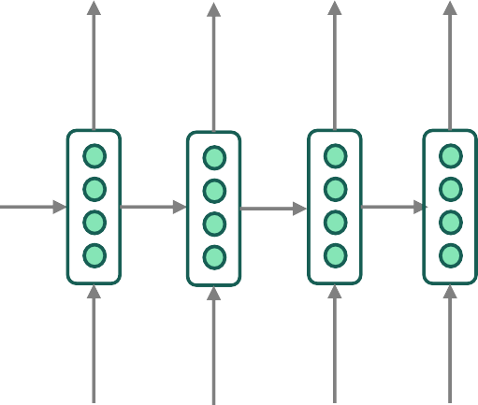
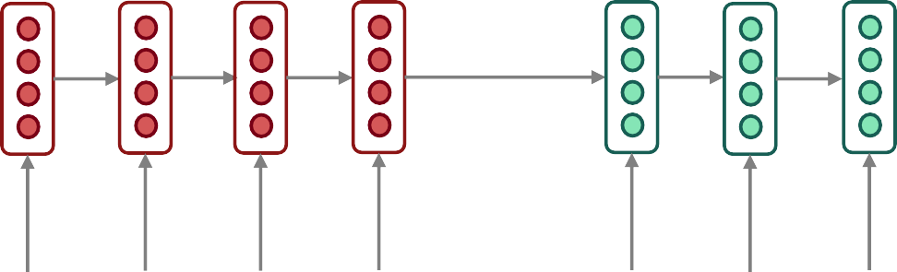
Neural Machine Translation (NMT)
The sequence-to-sequence model
Target sentence (output)
Encoding of the source sentence.
Provides initial hidden state for Decoder RNN.
he hit me
with
a pie <END>
argmax
argmax
argmax
argmax
argmax
argmax
argmax
Encoder RNN
Decoder RNN
il a
m’ entarté
<START> he hit me with a pie
Source sentence (input)
Decoder RNN is a Language Model that generates target sentence, conditioned on encoding.
Encoder RNN produces an encoding of the source sentence.
Note: This diagram shows test time behavior: decoder output is fed in as next step’s input

Slide 21
Sequence-to-sequence is versatile!
Sequence-to-sequence is useful for more than just MT
Many NLP tasks can be phrased as sequence-to-sequence:
Summarization (long text → short text)
Dialogue (previous utterances → next utterance)
Parsing (input text → output parse as sequence)
Code generation (natural language → Python code)

Slide 22
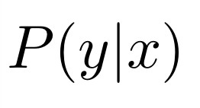
Neural Machine Translation (NMT)
The sequence-to-sequence model is an example of a Conditional Language Model
Language Model because the decoder is predicting the next word of the target sentence y
Conditional because its predictions are also conditioned on the source sentence x
NMT directly calculates :
Probability of next target word, given target words so far and source sentence x
Question: How to train a NMT system?
Answer: Get a big parallel corpus…

Slide 23
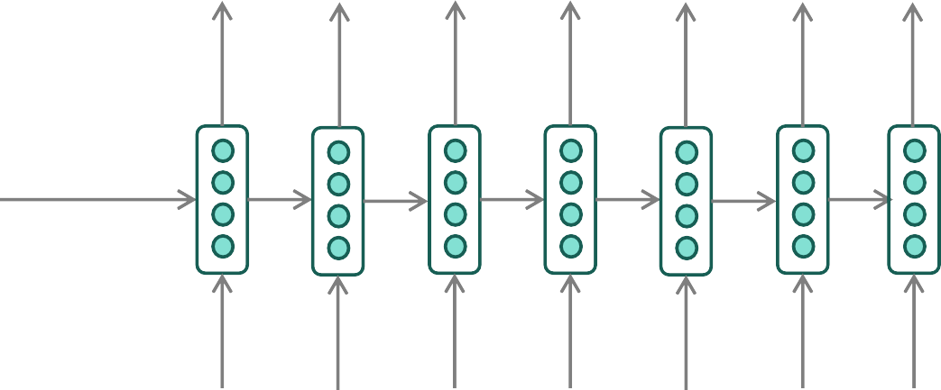
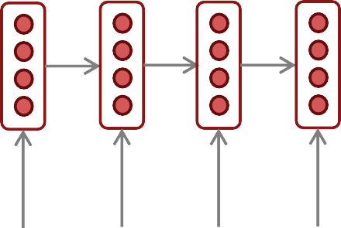
Training a Neural Machine Translation system
= negative log prob of “he”
= negative log prob of “with”
= negative log prob of <END>
1
𝐽 = _{𝑇} ∑ 𝐽_{𝑡}
=
𝐽₁
+
𝐽₂
𝐽₃
𝐽₄
+
𝐽₅
𝐽₆
𝐽₇
+
+ +
𝑡=1
𝑦^₁
𝑦^₂
𝑦^₃
𝑦^₄
𝑦^₅
𝑦^₆
𝑦^₇
Encoder RNN
Decoder RNN
il a m’ entarté
Source sentence (from corpus)
<START> he hit me with
Target sentence (from corpus)
a pie
Seq2seq is optimized as a single system. Backpropagation operates “end-to-end”.

Slide 24
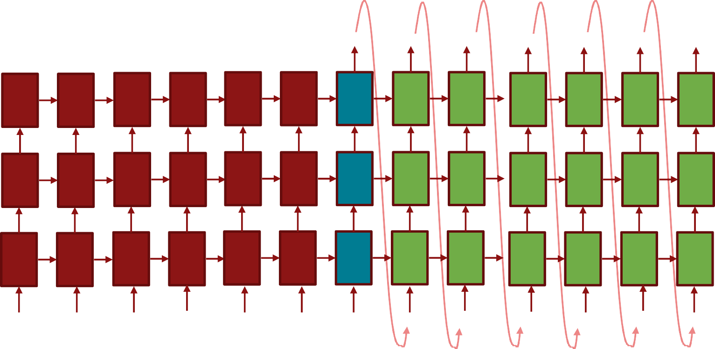


Multi-layer deep encoder-decoder MT
The hidden states from RNN layer i are the inputs to RNN layer i+1
Translation generated
The protests escalated
over
the weekend <EOS>
0.1
0.3
0.1
-0.4
0.2
0.2
0.6
-0.1
-0.7
0.1
0.4
0.4
0.3
-0.2
-0.3
0.5
0.5
0.9
-0.3
-0.2
0.2
0.6
-0.1
-0.5
0.1
-0.1
0.6
-0.1
-0.7
0.1
0.2
0.6
-0.1
-0.7
0.1
0.2
0.6
-0.1
-0.7
0.1
0.3
0.6
-0.1
-0.7
0.1
0.4
0.4
-0.1
-0.7
0.1
-0.2
0.6
-0.1
-0.7
0.1
-0.4
0.6
-0.1
-0.7
0.1
-0.3
0.5
-0.1
-0.7
0.1
Encoder: Builds up sentence meaning
0.2
-0.2
-0.1
0.1
0.1
0.2
0.6
-0.1
-0.7
0.1
0.1
0.3
-0.1
-0.7
0.1
0.2
0.6
-0.1
-0.4
0.1
0.2
-0.8
-0.1
-0.5
0.1
0.2
0.6
-0.1
-0.7
0.1
0.2
-0.1
-0.1
-0.7
0.1
-0.4
0.6
-0.1
-0.7
0.1
0.2
0.6
-0.1
0.3
0.1
-0.1
0.6
-0.1
0.3
0.1
0.2
0.4
-0.1
0.2
0.1
0.3
0.6
-0.1
-0.5
0.1
0.2
0.6
-0.1
-0.7
0.1
Decoder
0.2
0.6
-0.1
-0.7
0.1
0.4
-0.6
0.2
-0.3
0.4
0.2
-0.3
-0.1
-0.4
0.2
0.2
0.4
0.1
-0.5
-0.2
0.4
-0.2
-0.3
-0.4
-0.2
0.2
0.6
-0.1
-0.7
0.1
0.2
0.6
-0.1
-0.7
0.1
0.2
0.6
-0.1
-0.7
0.1
0.2
0.6
-0.1
-0.7
0.1
-0.1
0.3
-0.1
-0.7
0.1
-0.2
0.6
0.1
0.3
0.1
-0.4
0.5
-0.5
0.4
0.1
0.2
0.6
-0.1
-0.7
0.1
Source sentence
Die Proteste
waren
am Wochenende eskaliert <EOS>
The protests
escalated
over
The weekend
Feeding in last word
Conditioning =
Bottleneck

Slide 25
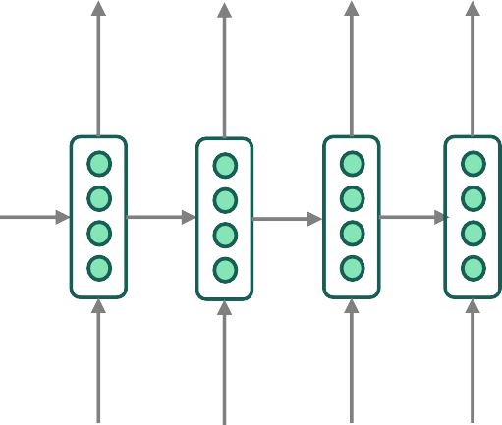
Greedy decoding
We saw how to generate (or “decode”) the target sentence by taking argmax on each step of the decoder
He hit me with a pie <END>
argmax
argmax
argmax
argmax
argmax
argmax
argmax
<START> he hit me with a pie
This is greedy decoding (take most probable word on each step)
Problems with this method?

Slide 26
Problems with greedy decoding
Greedy decoding has no way to undo decisions!
Input: il a m’entarté
→ he
→ he hit
→ he hit a
(he hit me with a pie)
(whoops! no going back now…)
How to fix this?

Slide 27
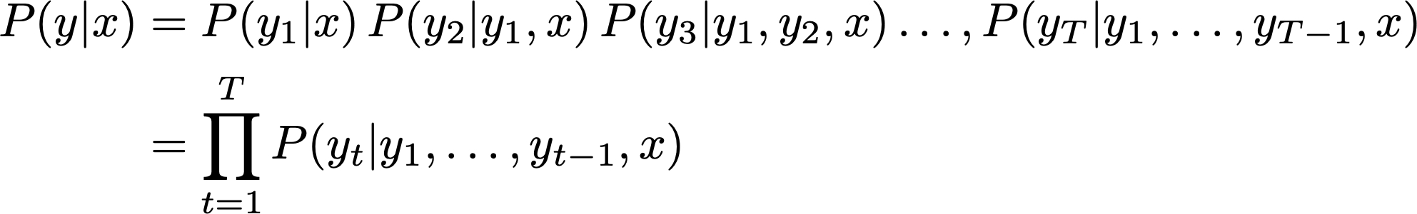
Exhaustive search decoding
Ideally, we want to find a (length T) translation y that maximizes
We could try computing all possible sequences y
This means that on each step t of the decoder, we’re tracking V^{t} possible partial translations, where V is vocab size
This O(V^{T}) complexity is far too expensive!

Slide 28
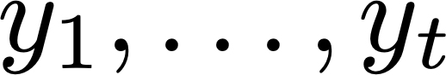
Beam search decoding
Core idea: On each step of decoder, keep track of the k most probable partial translations (which we call hypotheses)
k is the beam size (in practice around 5 to 10)
An hypothesis has a score which is its log probability:
Scores are all negative, and higher score is better
We search for high-scoring hypotheses, tracking top k on each step
Beam search is not guaranteed to find optimal solution
But much more efficient than exhaustive search!

Slide 29
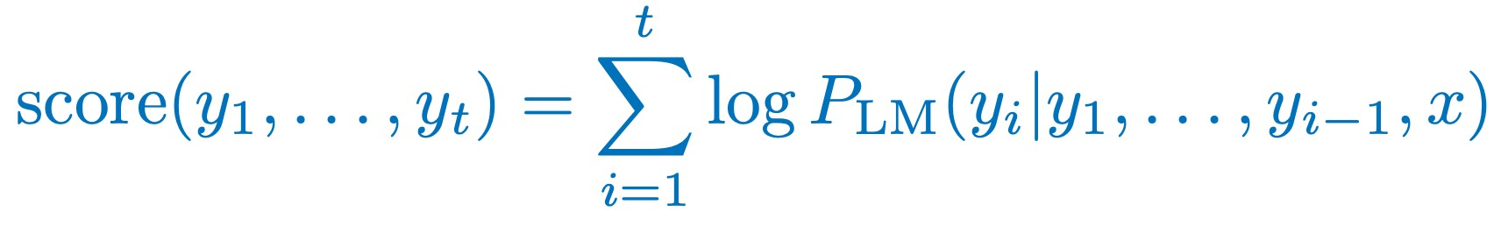
Beam search decoding: example
Beam size = k = 2. Blue numbers =
<START>
Calculate prob dist of next word

Slide 30
Beam search decoding: example
Beam size = k = 2. Blue numbers =
-0.7= log P_{LM}(he|<START>)
he
<START>
I
-0.9 = log P_{LM}(I|<START>)
Take top k words and compute scores

Slide 31
Beam search decoding: example
Beam size = k = 2. Blue numbers =
-1.7 = log P_{LM}(hit|<START> he) + -0.7
-0.7
hit
he
struck
-2.9 = log P_{LM}(struck|<START> he) + -0.7
-1.6 = log P_{LM}(was|<START> I) + -0.9
<START>
was
I
got
-0.9
-1.8 = log P_{LM}(got|<START> I) + -0.9
For each of the k hypotheses, find top k next words and calculate scores

Slide 32
Beam search decoding: example
Beam size = k = 2. Blue numbers =
-1.7
-0.7
hit
he
struck
-2.9
<START>
-1.6
was
I
got
-0.9
-1.8
Of these k² hypotheses, just keep k with highest scores

Slide 33
Beam search decoding: example
Beam size = k = 2. Blue numbers =
-2.8 = log P_{LM}(a|<START> he hit) + -1.7
-1.7
a
-0.7
hit
he
me
struck
-2.5 = log P_{LM}(me|<START> he hit) + -1.7
-2.9 = log P_{LM}(hit|<START> I was) + -1.6
-2.9
<START>
-1.6
hit
was
I
struck
got
-0.9
-3.8 = log P_{LM}(struck|<START> I was) + -1.6
-1.8
For each of the k hypotheses, find top k next words and calculate scores

Slide 34
Beam search decoding: example
Beam size = k = 2. Blue numbers =
-2.8
-1.7
a
-0.7
hit
he
me
struck
-2.5
-2.9
<START>
-2.9
-1.6
hit
was
I
struck
got
-0.9
-3.8
-1.8
Of these k² hypotheses, just keep k with highest scores

Slide 35
Beam search decoding: example
Beam size = k = 2. Blue numbers =
-4.0
tart
-2.8
pie
-1.7
a
-0.7
hit
-3.4
-3.3
he
me
struck
-2.5
with
-2.9
<START>
-2.9
on
-1.6
hit
-3.5
was
I
struck
got
-0.9
-3.8
-1.8
For each of the k hypotheses, find top k next words and calculate scores

Slide 36
Beam search decoding: example
Beam size = k = 2. Blue numbers =
-4.0
tart
-2.8
pie
-1.7
a
-0.7
hit
-3.4
-3.3
he
me
struck
-2.5
with
-2.9
<START>
-2.9
on
-1.6
hit
-3.5
was
I
struck
got
-0.9
-3.8
-1.8
Of these k² hypotheses, just keep k with highest scores

Slide 37
Beam search decoding: example
Beam size = k = 2. Blue numbers =
-4.0
-4.8
tart
in
-2.8
pie
with
-1.7
a
-4.5
-3.7
-0.7
hit
-3.4
-3.3
he
me
struck
-2.5
with
a
-2.9
<START>
-2.9
on
one
-1.6
hit
-3.5
-4.3
was
I
struck
got
-0.9
-3.8
-1.8
For each of the k hypotheses, find top k next words and calculate scores

Slide 38
Beam search decoding: example
Beam size = k = 2. Blue numbers =
-4.0
-4.8
tart
in
-2.8
pie
with
-1.7
a
-4.5
-3.7
-0.7
hit
-3.4
-3.3
he
me
struck
-2.5
with
a
-2.9
<START>
-2.9
on
one
-1.6
hit
-3.5
-4.3
was
I
struck
got
-0.9
-3.8
-1.8
Of these k² hypotheses, just keep k with highest scores

Slide 39
Beam search decoding: example
Beam size = k = 2. Blue numbers =
-4.0
-4.8
tart
in
-2.8
-4.3
pie
with
-1.7
a
pie
-4.5
-3.7
-0.7
hit
-3.4
-3.3
he
me
tart
struck
-2.5
with
a
-4.6
-2.9
<START>
-2.9
on
one
-5.0
-1.6
hit
pie
-3.5
-4.3
was
I
struck
tart
got
-0.9
-3.8
-5.3
-1.8
For each of the k hypotheses, find top k next words and calculate scores

Slide 40
Beam search decoding: example
Beam size = k = 2. Blue numbers =
-4.0
-4.8
tart
in
-2.8
-4.3
pie
with
-1.7
a
pie
-4.5
-3.7
-0.7
hit
-3.4
-3.3
he
me
tart
struck
-2.5
with
a
-4.6
-2.9
<START>
-2.9
on
one
-5.0
-1.6
hit
pie
-3.5
-4.3
was
I
struck
tart
got
-0.9
-3.8
-5.3
-1.8
This is the top-scoring hypothesis!

Slide 41
Beam search decoding: example
Beam size = k = 2. Blue numbers =
-4.0
-4.8
tart
in
-2.8
-4.3
pie
with
-1.7
a
pie
-4.5
-3.7
-0.7
hit
-3.4
-3.3
he
me
tart
struck
-2.5
with
a
-4.6
-2.9
<START>
-2.9
on
one
-5.0
-1.6
hit
pie
-3.5
-4.3
was
I
struck
tart
got
-0.9
-3.8
-5.3
-1.8
Backtrack to obtain the full hypothesis

Slide 42
Beam search decoding: stopping criterion
In greedy decoding, usually we decode until the model produces an <END> token
For example: <START> he hit me with a pie <END>
In beam search decoding, different hypotheses may produce <END> tokens on different timesteps
When a hypothesis produces <END>, that hypothesis is complete.
Place it aside and continue exploring other hypotheses via beam search.
Usually we continue beam search until:
We reach timestep T (where T is some pre-defined cutoff), or
We have at least n completed hypotheses (where n is pre-defined cutoff)

Slide 43
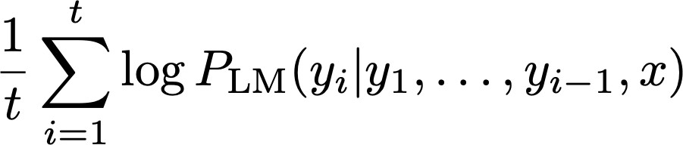
Beam search decoding: finishing up
We have our list of completed hypotheses.
How to select top one with highest score?
Each hypothesis on our list has a score
Problem with this: longer hypotheses have lower scores
Fix: Normalize by length. Use this to select top one instead:

Slide 44
Advantages of NMT
Compared to SMT, NMT has many advantages:
Better performance
More fluent
Better use of context
Better use of phrase similarities
A single neural network to be optimized end-to-end
No subcomponents to be individually optimized
Requires much less human engineering effort
No feature engineering
Same method for all language pairs

Slide 45
Disadvantages of NMT?
Compared to SMT:
NMT is less interpretable
Hard to debug
NMT is difficult to control
For example, can’t easily specify rules or guidelines for translation
Safety concerns!

Slide 46
How do we evaluate Machine Translation?
BLEU (Bilingual Evaluation Understudy)
BLEU compares the machine-written translation to one or several human-written translation(s), and computes a similarity score based on:
n-gram precision (usually for 1, 2, 3 and 4-grams)
Plus a penalty for too-short system translations
BLEU is useful but imperfect
There are many valid ways to translate a sentence
So a good translation can get a poor BLEU score because it has low n-gram overlap with the human translation ☹
Source: ”BLEU: a Method for Automatic Evaluation of Machine Translation", Papineni et al, 2002. http://aclweb.org/anthology/P02-1040

Slide 47
So, is Machine Translation solved?
Nope!
Many difficulties remain:
Out-of-vocabulary words
Domain mismatch between train and test data
Maintaining context over longer text
Low-resource language pairs
Failures to accurately capture sentence meaning
Pronoun (or zero pronoun) resolution errors
Further reading: “Has AI surpassed humans at translation? Not even close!”
https://www.skynettoday.com/editorials/state_of_nmt

Slide 48


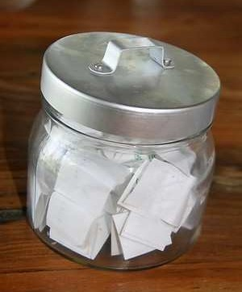
So is Machine Translation solved?
Nope!
Using common sense is still hard
?

Slide 49
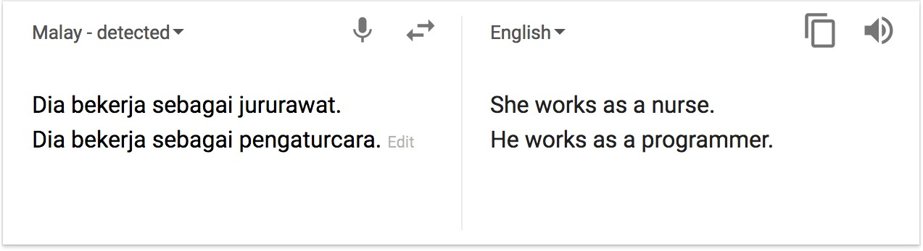
So is Machine Translation solved?
Nope!
NMT picks up biases in training data
Didn’t specify gender
Source: https://hackernoon.com/bias-sexist-or-this-is-the-way-it-should-be-ce1f7c8c683c

Slide 50
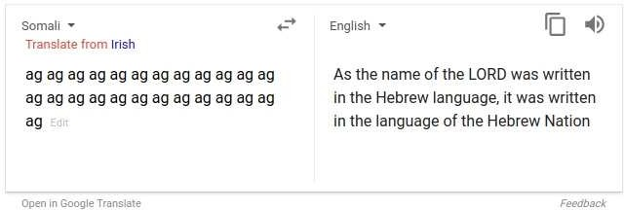
So is Machine Translation solved?
Nope!
Uninterpretable systems do strange things
(But I think this problem has been fixed in Google Translate by 2021?)
Picture source: https://www.vice.com/en_uk/article/j5npeg/why-is-google-translate-spitting-out-sinister-religious-prophecies
Explanation: https://www.skynettoday.com/briefs/google-nmt-prophecies

Slide 51
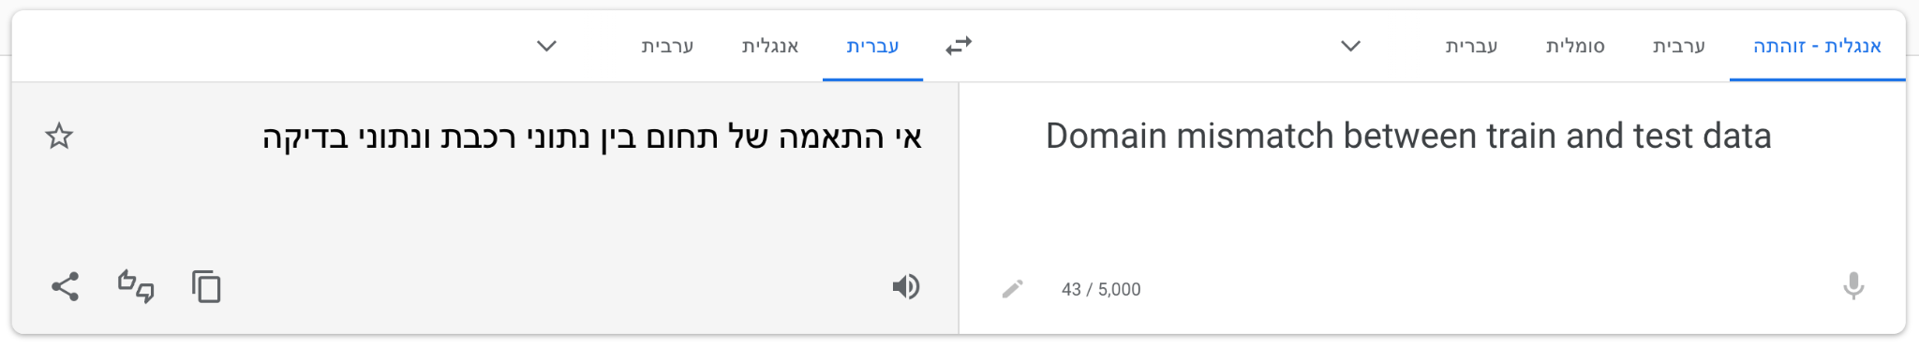
So is Machine Translation solved?
Nope!
Domain mismatch between train and test data

Slide 52
NMT research continues
NMT is a flagship task for NLP Deep Learning
NMT research has pioneered many of the recent innovations of NLP Deep Learning
In 2022: NMT research continues to thrive
Researchers have found many, many improvements to the “vanilla” seq2seq NMT system we’ve just presented
But we’ll present in a minute one improvement so integral that it is the new vanilla…
ATTENTION

Slide 53
Today’s Agenda
Short recap (RNN, LSTM)
Machine Translation (Seq2seq)
Attention

Slide 54
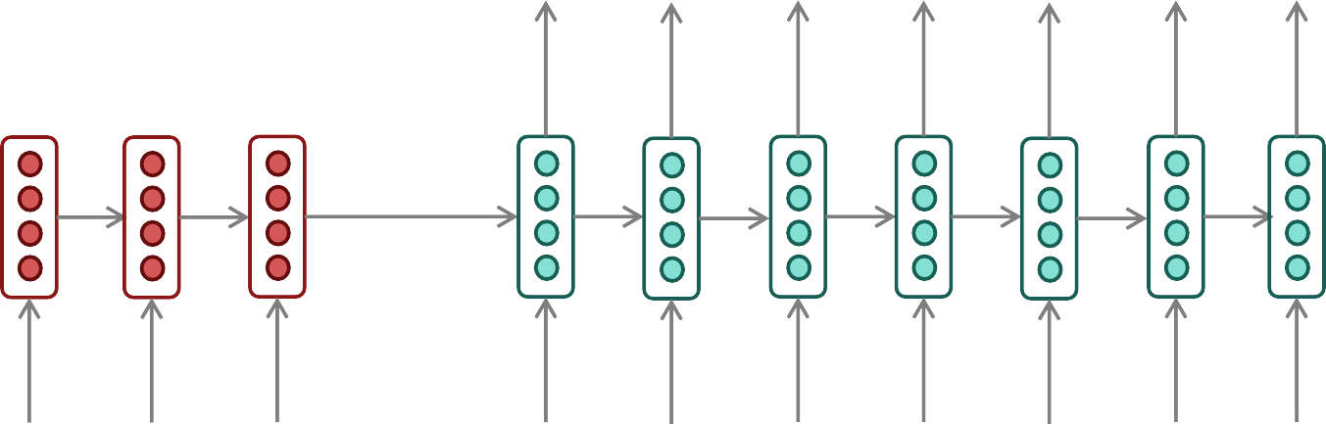
Sequence-to-sequence: the bottleneck problem
Encoding of the source sentence.
Target sentence (output)
he hit me with a
pie <END>
Encoder RNN
Decoder RNN
il
a m’ entarté
<START>
he hit me with
a pie
Source sentence (input)
Problems with this architecture?

Slide 55
Sequence-to-sequence: the bottleneck problem
Encoding of the source sentence.
This needs to capture all information about the source sentence.
Information bottleneck!
Target sentence (output)
he hit me with a
pie <END>
Encoder RNN
Decoder RNN
il
a m’ entarté
<START>
he hit me with
a pie
Source sentence (input)

Slide 56

Attention
Attention provides a solution to the bottleneck problem.
Core idea: on each step of the decoder, use direct connection to the encoder to focus on a particular part of the source sequence
First, we will show via diagram (no equations), then we will show with equations

Slide 57

Sequence-to-sequence with attention
dot product
Attention scores
Encoder RNN
Decoder RNN
il
a m’ entarté
<START>
Source sentence (input)

Slide 58

Sequence-to-sequence with attention
dot product
Attention scores
Encoder RNN
Decoder RNN
il
a m’ entarté
<START>
Source sentence (input)

Slide 59

Sequence-to-sequence with attention
dot product
Attention scores
Encoder RNN
Decoder RNN
il
a m’ entarté
<START>
Source sentence (input)

Slide 60

Sequence-to-sequence with attention
dot product
Attention scores
Encoder RNN
Decoder RNN
il
a m’ entarté
<START>
Source sentence (input)

Slide 61
Sequence-to-sequence with attention
On this decoder timestep, we’re mostly focusing on the first encoder hidden state (”he”)
Attention distribution
Take softmax to turn the scores into a probability distribution
Attention scores
Encoder RNN
Decoder RNN
il
a m’ entarté
<START>
Source sentence (input)

Slide 62

Sequence-to-sequence with attention
Attention output
Use the attention distribution to take a weighted sum of the encoder hidden states.
The attention output mostly contains information from the hidden states that received high attention.
Attention distribution
Attention scores
Encoder RNN
Decoder RNN
il
a m’ entarté
<START>
Source sentence (input)

Slide 63
Sequence-to-sequence with attention
Attention output
he
Concatenate attention output with decoder hidden state, then use to compute 𝑦^₁ as before
𝑦^₁
Attention distribution
Attention scores
Encoder RNN
Decoder RNN
il
a m’ entarté
<START>
Source sentence (input)

Slide 64


Sequence-to-sequence with attention
Attention output
hit
𝑦^₂
Attention distribution
Attention scores
Encoder RNN
Sometimes we take the attention output from the previous step, and also feed it into the decoder (along with the usual decoder input).
Decoder RNN
il
a m’ entarté
<START> he
Source sentence (input)

Slide 65


Sequence-to-sequence with attention
Attention output
me
𝑦^₃
Attention distribution
Attention scores
Encoder RNN
Decoder RNN
il
a m’ entarté
<START>
he hit
Source sentence (input)

Slide 66

Sequence-to-sequence with attention
Attention output
with
𝑦^₄
Attention distribution
Attention scores
Encoder RNN
Decoder RNN
il
a m’ entarté
<START>
he hit ^{me}
Source sentence (input)

Slide 67

Sequence-to-sequence with attention
Attention output
a
𝑦^₅
Attention distribution
Attention scores
Encoder RNN
Decoder RNN
il
a m’ entarté
<START>
he hit ^{me with}
Source sentence (input)

Slide 68

Sequence-to-sequence with attention
Attention output
pie
𝑦^₆
Attention distribution
Attention scores
Encoder RNN
Decoder RNN
il
a m’ entarté
<START>
he hit ^{me with}
a
Source sentence (input)

Slide 69











Attention: in equations
We have encoder hidden states
On timestep t, we have decoder hidden state
We get the attention scores for this step:
We take softmax to get the attention distribution sums to 1)
for this step (this is a probability distribution and
We use to take a weighted sum of the encoder hidden states to get the attention output
Finally we concatenate the attention output with the decoder hidden state and proceed as in the non-attention seq2seq model

Slide 70
Attention is great
Attention significantly improves NMT performance
It’s very useful to allow decoder to focus on certain parts of the source
Attention solves the bottleneck problem
Attention allows decoder to look directly at source; bypass bottleneck
Attention helps with vanishing gradient problem
Provides shortcut to faraway states
Attention provides some interpretability
By inspecting attention distribution, we can see
he
hit me with a pie
what the decoder was focusing on
We get (soft) alignment for free!
This is cool because we never explicitly trained an alignment system
The network just learned alignment by itself
il
a m’ entarté

